Slide 1
Dashboard Admin

Slide 2
User Name
Password
Forgot password?
Sign in

Slide 3
AAFT Online
AAFT Noida
ABS
ALC
AAFT University Raipur

Slide 4


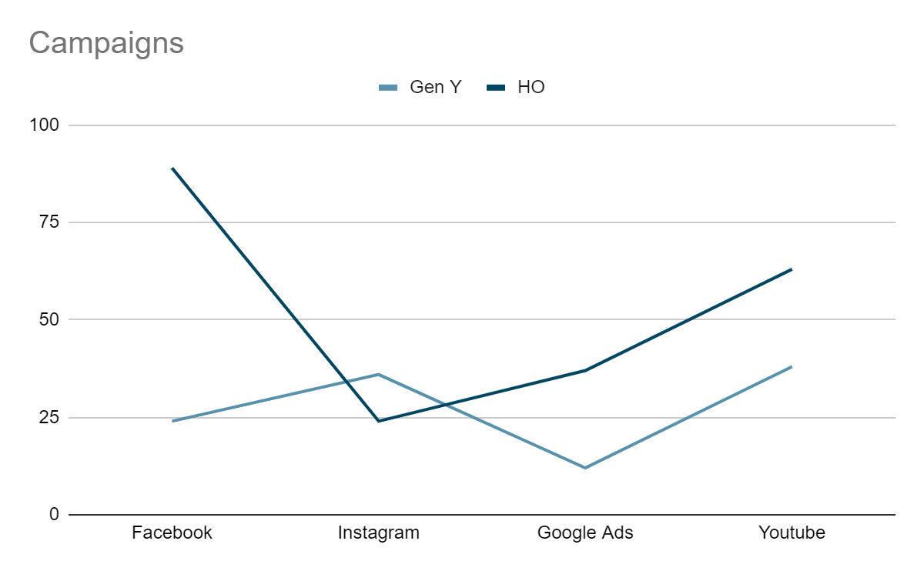
Facebook 23 %
Instagram 46 %
Google Ads 14%
LinkedIn 9%
HOME
CAMPAIGNS
LANDING PAGES
Course | Course Type | Agency | Campaign | Platform | Status
Fashion Design | Diploma | GenY | AOLT_HO_FDN_190823_New | Facebook | On hold
Fashion Design | Diploma | HO | HO_AAFT_Diploma_in_FashionDesign_(21-45)_Conversion | Facebook | Active

Slide 5
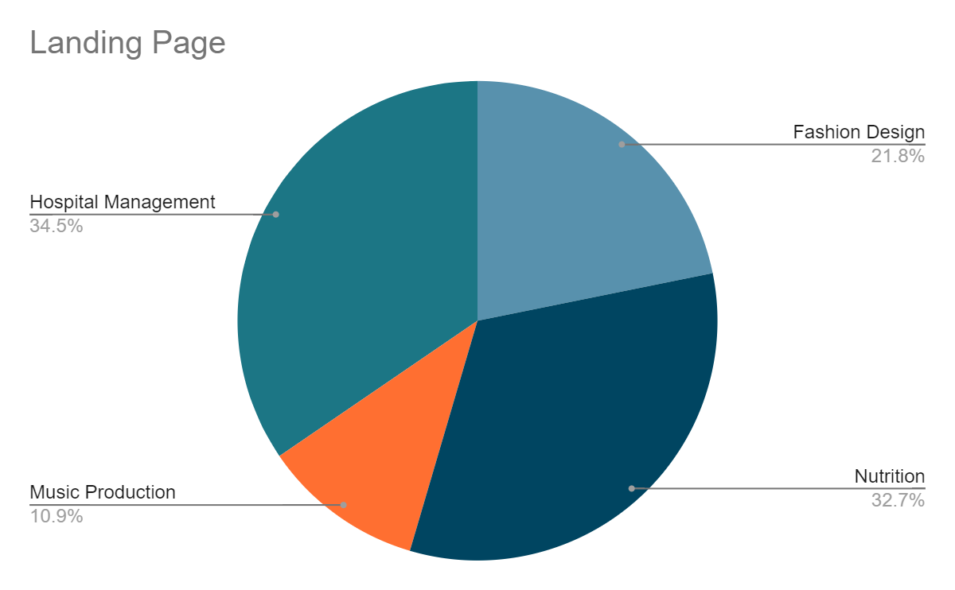
HOME
Notifications
LANDING PAGES
Course | Course Type | Institution | Description | Issue | Document | Status
Fashion Design | Diploma | ABS | Landing page for fashion design | Task | abc.pdf | In review
Fashion Design | Diploma | ALC | Landing page for | Update | xyz.pdf | Done

Slide 6
Marketing Agency External Dashboard

Slide 7

HOME
Notifications
CAMPAIGNS
Campaign | Status
AOLT_HO_FDN_190823_New | Approved
HO_AAFT_Diploma_in_FashionDesign_(21-45)_Conversion | Rejected
SETTINGS
Create
Institution | Program Type | Campaign | Lead Source | Course | Campaign Status
AAFT - Online | Diploma | AOLT_HO_FDN_190823_New | Facebook | Fashion Design | New
ABS | Diploma | HO_AAFT_Diploma_in_FashionDesign_(21-45)_Conversion | Facebook | Music | On hold

Slide 8


New Campaign
Institution
Program Type
Marketing Agency
Lead Source
Target Location
Persona
Price
Courses
Date (DD/MM/YY)
Headline
Target Segment
Type
Size
Version
Is this form published?
Have you done course interested as a parameter?
Generate
Cancel

Slide 9
Edit Campaign
Institution
Program Type
Marketing Agency
Lead Source
Target Location
Persona
Price
Courses
Date (DD/MM/YY)
Headline
Target Segment
Type
Size
Version
Non-editable
Campaign Name
Adset Name
Ad Name
Creative
Is this form published?
Have you done course interested as a parameter?
Update
Cancel

Slide 10
HOME
Campaigns
Create
CAMPAIGNS
Institution | Program Type | Campaign | Lead Source | Course | Campaign Status | Action
AAFT - Online | Diploma | AOLT_HO_FDN_190823_New | Facebook | Fashion Design | New
ABS | Diploma | HO_AAFT_Diploma_in_FashionDesign_(21-45)_Conversion | Facebook | Music | On hold
AAFT - Online | Diploma | AOLT_HO_FDN_190823_New | Facebook | Fashion Design | On hold
ABS | Diploma | HO_AAFT_Diploma_in_FashionDesign_(21-45)_Conversion | Facebook | Music | Active
SETTINGS
Edit
Lead Generation
Request to Edit
Request to Delete
Delete

Slide 11
Request to Edit
Do you wish to send the request to edit the campaign?
Request
Cancel
Request to Delete
Do you wish to send the request to delete the campaign?
Request
Cancel

Slide 12
Lead Generation
Do you wish to send the request to check if lead is generated in CRM?
Request
Cancel

Slide 13
Marketing AAFT Dashboard

Slide 14
HOME
Notifications
LANDING PAGES
Course | Course Type | Institution | Description | Issue | Document | Status
Fashion Design | Diploma | ABS | Landing page for fashion design | Task | abc.pdf | In review
Fashion Design | Diploma | ALC | Landing page for | Update | xyz.pdf | Done

Slide 15

HOME
LANDING PAGES
Create
LANDING PAGES
Course | Course Type | Institution Type | Description | Issue | Status | Document | Assignee | Action
Fashion Design | Diploma | ABS | Landing page for fashion design | Task | To Do | abc.pdf | Vijender
Fashion Design | Diploma | ALC | Landing page for | Update | To Do | xyz.pdf | Jitender
Fashion Design | Diploma | AAFT Online | Landing page for | Task | In Review | xyz.pdf | Vijender
Fashion Design | Diploma | AAFT Raipur | Landing page for | Update | In Review | xyz.pdf | Jitender

Slide 16
New Landing Page
Course Type
Institution Type
Course Name
Title
Assignee
Development Type
Issue
Priority
Description
Upload
Generate
Cancel

Slide 17



HOME
Title
To Do
Description
LANDING PAGES
Organization Type
Course Type
Course
Assignee
Priority
Development Type
SETTINGS
abc.pdf
1. comments
2. comments

Slide 18
HOME
Campaigns
LANDING PAGES
Course | Course Type | Agency Type | Campaign | Platform | Campaign Status | Action
Fashion Design | Diploma | HO | AOLT_HO_FDN_190823_New | Facebook | New
Fashion Design | Diploma | GENY | GENY_AAFT_Diploma_in_FashionDesign_(21-45)_Conversion | Facebook | Active
Campaigns
SETTINGS

Slide 19
Campaign Approval
Institution
Program Type
Lead Source
Course
Campaign Name
Status
Approve
Reject

Slide 20
IT Admin Dashboard

Slide 21
HOME
Notifications
LANDING PAGES
Campaign | Status
AOLT_HO_FDN_190823_New | Approved
HO_AAFT_Diploma_in_FashionDesign_(21-45)_Conversion | Rejected
CAMPAIGNS
SETTINGS
SETTINGS
Course | Course Type | Institution | Description | Issue | Document | Status
Fashion Design | Diploma | ABS | Landing page for fashion design | Task | abc.pdf | In review
Fashion Design | Diploma | ALC | Landing page for | Update | xyz.pdf | Done

Slide 22
HOME
Landing Pages
LANDING PAGES
Course | Course Type | Institution Type | Description | Issue | Status | Document | Assigner | Assignee | Action
Fashion Design | Diploma | ABS | Landing page for fashion design | Task | To Do | abc.pdf | Abishai | Vijender
MBA | Diploma | ABS | Landing page for MBA | Update | To Do | xyz.pdf | Abishai | Jitender
Campaigns
View
SETTINGS
View

Slide 23
HOME
Title
To Do
Description
LANDING PAGES
Organization Type
Course Type
Course
Assigner
Priority
Development Type
CAMPAIGNS
abc.pdf
SETTINGS
1. comments
2. comments

Slide 24
HOME
Campaigns
LANDING PAGES
Institution | Program Type | Campaign | Lead Source | Course | Campaign Status | Action
AAFT - Online | Diploma | AOLT_HO_FDN_190823_New | Facebook | Fashion Design | New
ABS | Diploma | HO_AAFT_Diploma_in_FashionDesign_(21-45)_Conversion | Facebook | Music | On hold
AAFT - Online | Diploma | AOLT_HO_FDN_190823_New | Facebook | Fashion Design | On hold
ABS | Diploma | HO_AAFT_Diploma_in_FashionDesign_(21-45)_Conversion | Facebook | Music | Active
Campaigns
Lead Request
SETTINGS
View
Allow Edit
View
Allow Delete
View
View
Lead Request Acceptance

Slide 25
Request to Edit
Do you wish to allow the request to edit the campaign?
Allow
Cancel
Request to Delete
Do you wish to allow the request to delete the campaign?
Allow
Cancel

Slide 26
Lead Request
Do you wish to send the request to check if lead is generated in CRM?
Request
Cancel
Lead Acceptance
Do you wish to inform that the lead request is generated in CRM ?
Accept
Cancel

Slide 27
HOME
Campaigns
LANDING PAGES
Institution - AAFT Online
Program Type - Diploma
Marketing Agency - GENY
Lead Source - Facebook
Target Location - Tier - 3
Persona - Persona - 1
Price - With Fee
Courses - Fashion Design
Date - 02/02/24
Headline - Course Name
Target Segment - Women
Type - Reel
Size - 800 * 600
Version - First
Campaign Status - New
Campaign Name - AOLT-HO-FDN-ABC
Adset Name - xyz
Creative - abc
Campaigns
SETTINGS

Slide 28
IT Dashboard

Slide 29
HOME
Notifications
LANDING PAGES
Description | Issue | Status
Landing page for fashion design | Task | To Do
Landing page for MBA | Bug | To Do
CAMPAIGNS
SETTINGS
Course | Course Type | Institution Type | Description | Issue | Status | Document | Action
Fashion Design | Diploma | ABS | Landing page for fashion design | Task | To Do | abc.pdf
MBA | Diploma | ABS | Landing page for MBA | Update | To Do | xyz.pdf

Slide 30
HOME
Title
To Do
Description
LANDING PAGES
Organization Type
Course Type
Course
Assigner
Priority
Development Type
CAMPAIGNS
abc.pdf
SETTINGS
1. comments
2. comments

